Slide 1

Modules and Concurrency
Samer Buna
SOFTWARE ARCHITECT – AGILELABS
@samerbuna | samer.dev

Slide 2
Modules (exports/require)
Concurrency (Without THREADS!)

Slide 3
Defining and Using Node Modules

Slide 4

What exactly is a Module?

Slide 5
Module (In Node.js)
A file (or a folder) that contains code

Slide 6
Node’s Global Object

Slide 7
The Event Loop

Slide 8
The Event Loop
What Node uses to process asynchronous actions and interface them for you so that you don’t have to deal with threads

Slide 9
Errors vs Exceptions

Slide 10
Errors vs Exceptions
Error is “Problem”
Exception is “Condition”

Slide 11
Node Clusters

Slide 12
#1 #2 #3 #4
Master
#5 #6 #7 #8

Slide 13
#1 #2 #3 #4
Master

Slide 14

Master
#1

Slide 15
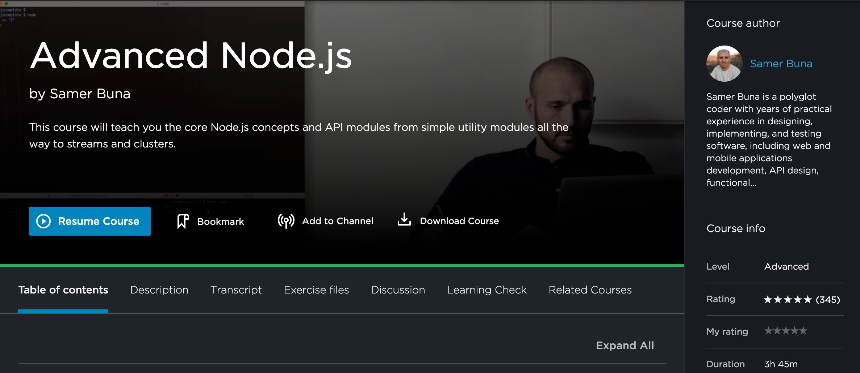
samer.dev/adv-nodejs

Slide 16
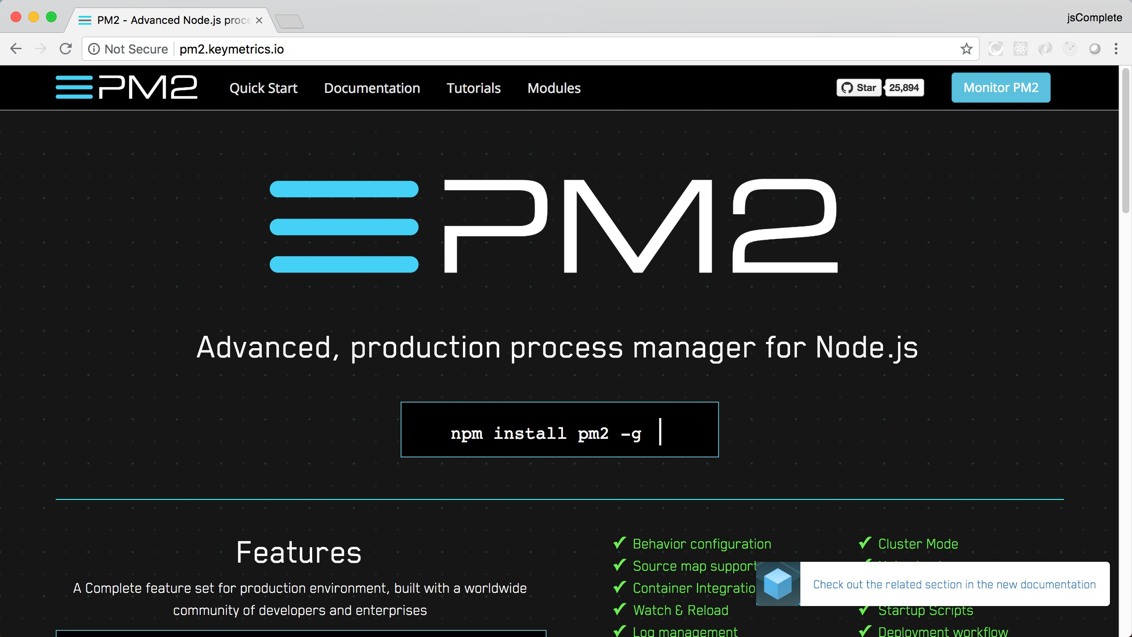

Slide 17
Node’s Asynchronous Patterns

Slide 18
ECMAScript Modules

Slide 19
Event Emitters

Slide 20

Node Modules
Types of APIs
Wrap Up
The “global” Object
The “Event Loop” Error handling
Clusters
Asynchronous patterns EventEmitter

Slide 21
Next Up
Working with Web Servers

